Slide 1

Plant Pals
Customer Survey Results
We surveyed 50 Plant Pals test batch customers over a four-week period to learn about their satisfaction with the product, delivery process, and customer support.

Slide 2
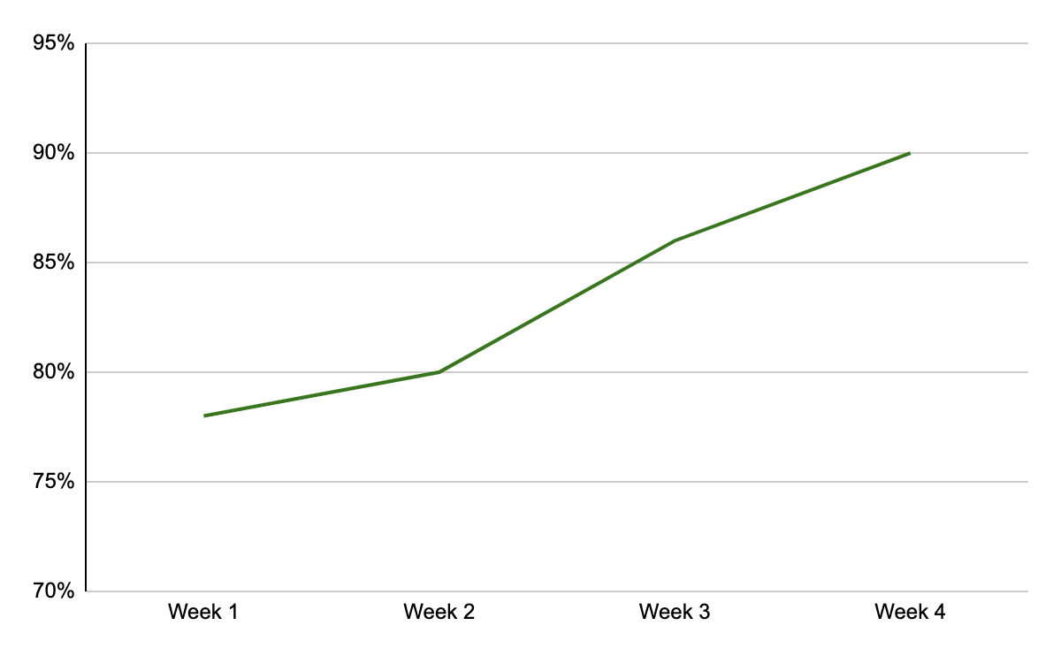
Did your shipment arrive on time?
Key takeaways & action items: On-time deliveries rose to 90% by the end of the survey—a solid improvement, but still short of our 95% target. Investigate additional reasons for late deliveries.

Slide 3
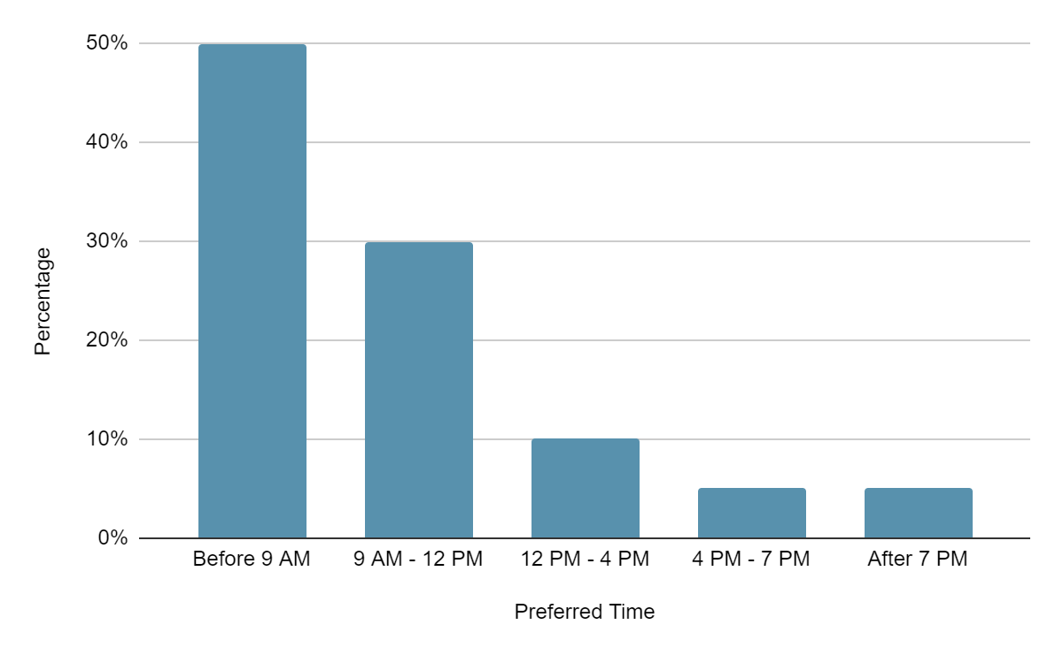
What is your preferred time of day to receive a shipment from Plant Pals?
Key takeaways & action items: Customers overwhelmingly prefer deliveries before normal business hours and early in the day. Consider scheduling more early delivery routes, which could help raise successful, on-time deliveries to 95%.

Slide 4
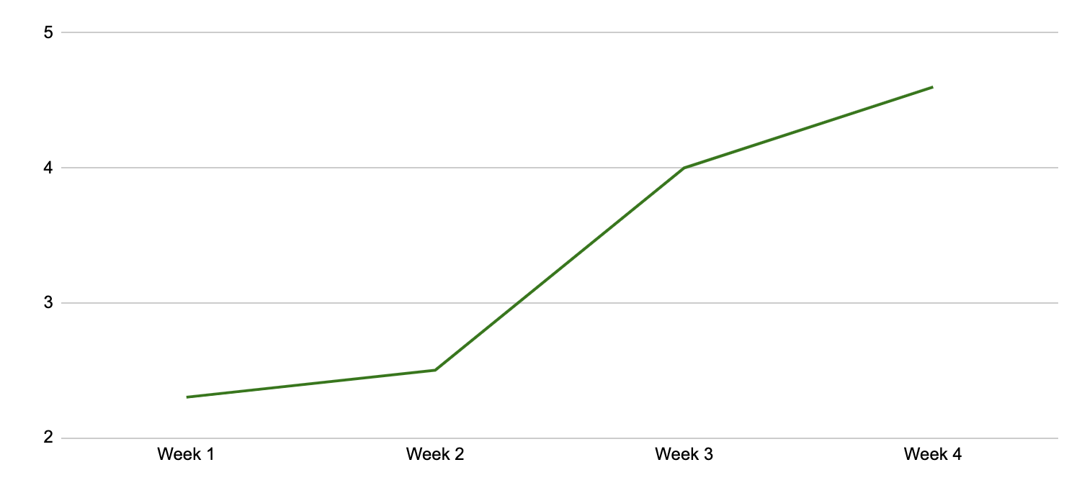
On a scale of 1 to 5, with 1 being the lowest and 5 being the highest, how satisfied are you with customer support?
Key takeaways & action items: Satisfaction with support increased once we fixed the customer service software problem. There is still room for improvement, so continue to monitor responses and solutions to support tickets.

Slide 5
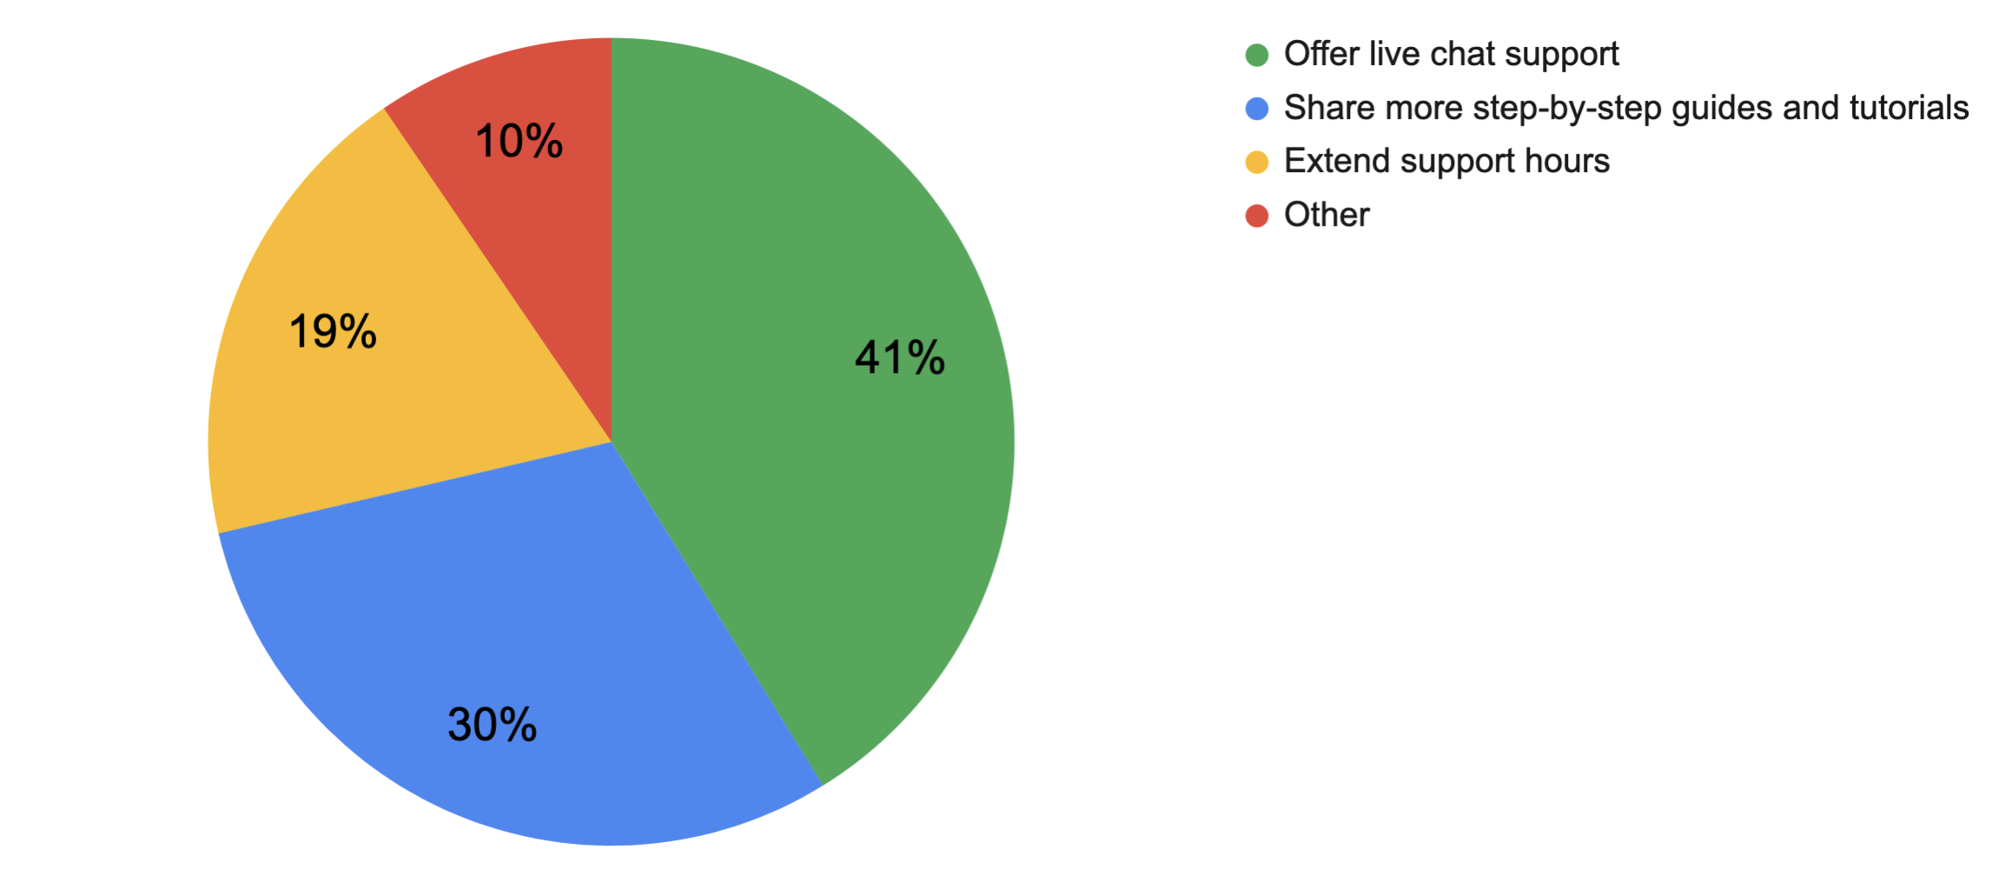
In general, how do you suggest we improve our customer support?
Key takeaways & action items: A number of customers volunteered that a live chat option would improve customer support. Also, many respondents found the guides and tutorials helpful. Research expanding these offerings for specific plant species.

Slide 6
Conclusion and next steps
Previous survey results revealed some initial issues with the test launch. The latest results indicate we have successfully addressed some of those issues:
Hiring more drivers led to a ~10% increase in on-time deliveries
Customer satisfaction increased once we resolved the known technical issues
However, there is still room for improvement. We recommend:
Focus on early deliveries to meet on-time delivery target
Customers prefer the live chat support option. Consider allocating more support resources to live chat support. Continue to create tutorials and guides for new offerings.
Continue to survey consistently and monitor results for additional improvements

